Slide 1


When CSI Meets Public Wi-Fi: Inferring your Mobile Password via Wi-Fi Signals
Zifan Qu

Slide 2
Introduction
Smartphones and tablets are commonly used for performing privacy sensitive transactions of banking, payment, and social applications.
Two types of eavesdropping attacks:
Directly observing input from screen and keyboard
Side channel attacks to infer input – Using video from a camera, acoustic signal at microphone, motion sensors, electromagnetic signal at radio antenna, etc.
previous works on the latter make one of two assumptions:
There is one (or more) external device(s) to collect the required signals
The target device’s sensors are compromised to provide side channel information
Notes:
Former is easy enough, but
Is either one practical in day-to-day life?
What is an attacker’s main aim? All the content or the password to the account?
First, lets see some background.
Nowadays, mobile devices are used for preforming sensitive transaction of bank and payment.
Compared to the stationary devices connecting to a secure network, the mobile devices such like smartphones and tablets are commonly carried by users to dynamic network environment, which makes attackers could eavesdrop users’ sensitive input like PIN code.
For now, there has two types of eavesdrop attack,
Direct eavesdropping attacks which obtain the input from screen and keyboard.
And indirect eavesdropping attacks, also known as side-channel attacks, which infer the input using mobile devices sensor like camera, microphone and motion sensors, or use external devices.
In this paper,, We focus on the indirect eavesdropping attack using side channel information.

Slide 3
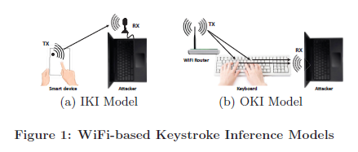
Previous Approach – Out-of-band Keystroke Inference (OKI) model
Adversary deploys two Wi-Fi devices close to the target device and makes sure the target device is placed right between the two.
One is the sender device and the other one is the receiver device.
The keystrokes are inferred from the multi-path distortions in signals.
Notes:
Here is a description of indirect eavesdropping attack using external device, called OKI model.
The attacker needs to deploy two wifi devices, one is the sender devices continuous emitting signals and the receiver device receive the signals. The target device must be put between the two wifi devices and the target device can only be an external keyboard.
This method is not stealthy, and can only infer the input from mechanical keyboard, which is not practical in today’s transaction Scenario, which makes it not practical.

Slide 4
WindTalker!!
A novel and practical keystroke inference framework that allows an attacker to infer the sensitive keystrokes on a mobile device through Wi-Fi signals.
Deploys rogue hotspot, unlike previous works which deploy external devices close to the target device or compromise the sensors.
Challenges in design:
Signal analysis to analyse keystrokes from the limited Channel State Information
Prior CSI collection method required two Wi-Fi devices which are deployed close to the victim. More practical method needed
The key inference must be done at some selective moments for obtaining a sensitive keystroke, such as payment PIN
Notes:
To improve the way of eavesdropping user’s sensitive input,
Windtalker uses side channel information to analyze signal of mobile device to infer the keystroke. Unlike the previous OKI model, which can only infer all inputs, windtalker implement a new feature that can identify the specific prior when user input sensitive keystroke.

Slide 5
In-band Keystroke Inference (IKI) model
The Wi-Fi hotspot provides free Wi-Fi networks for nearby users.
When a user connects their device to the hotspot, the Wi-Fi hotspot is able to monitor the application context.
In addition, the Wi-Fi hotspot periodically sends ICMP packets to obtain the CSI information from the target device.
When a sensitive operation is detected, the hotspot adaptively launches its keystroke inference method.
Notes:
Windtalker uses a IKI model
Unlike the OKI model, The IKI model only need to deploy one wifi device, which can be a NIC(network interface controller) on a laptop. The wifi device pretend to be a public wifi hotspot to collect target device‘s side-channel information for inferring sensitive input.
What’s more, the IKI model allows attacker to collect un-encrypted meta data traffic and collect CSI data to infer the keystroke.

Slide 6
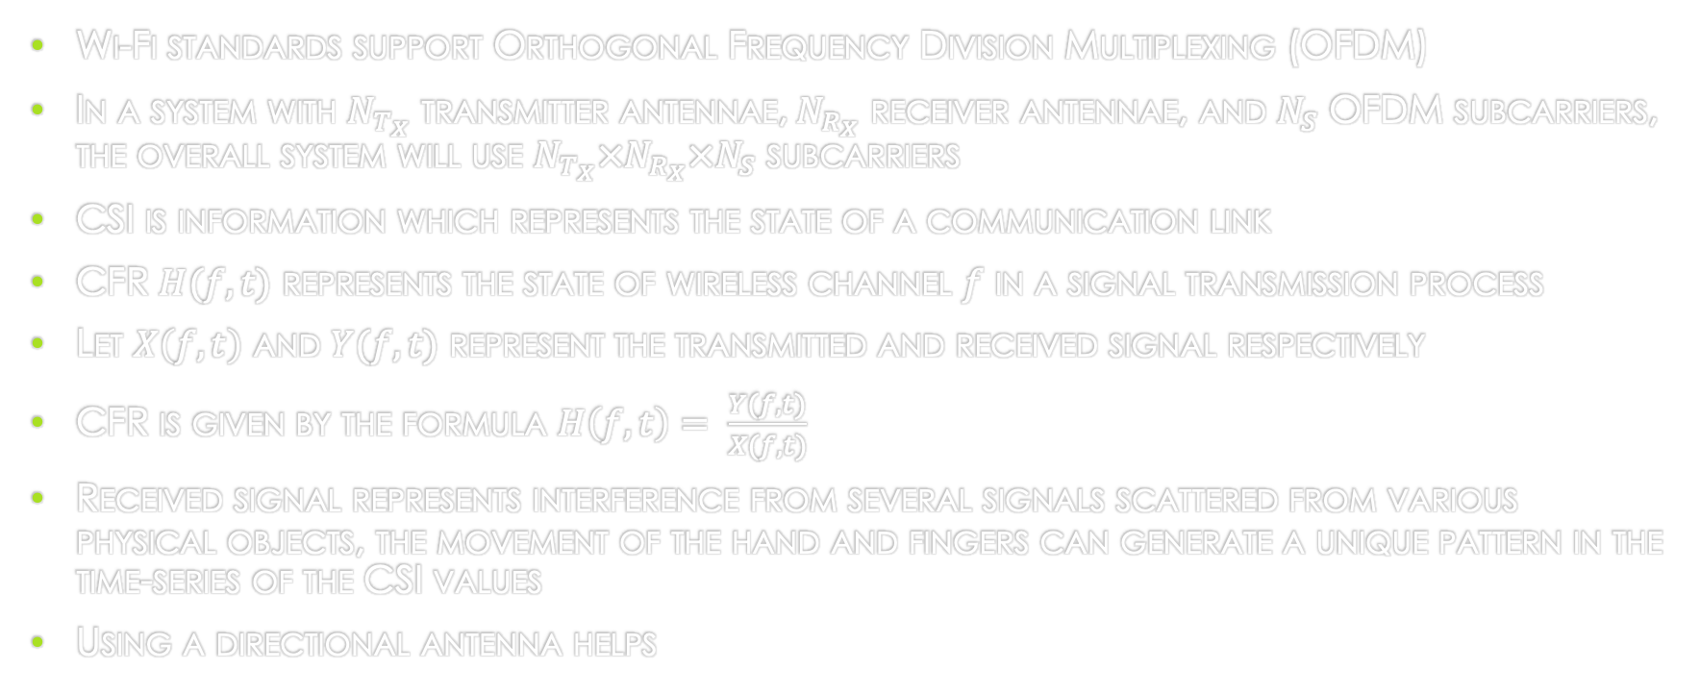
Channel State Information (CSI)
Wi-Fi standards support Orthogonal Frequency Division Multiplexing (OFDM)
In a system with $N_{T_{X}}$ transmitter antennae,$N_{R_{X}}$ receiver antennae, and $N_{S}$ OFDM subcarriers, the overall system will use $N_{T_{X}}×N_{R_{X}}×N_{S}$ subcarriers
CSI is information which represents the state of a communication link
CFR $H(f,t)$ represents the state of wireless channel $f$ in a signal transmission process
Let $X\left(f,t\right)$ and $Y(f,t)$ represent the transmitted and received signal respectively
CFR is given by the formula $H\left(f,t\right)= \frac{Y(f,t)}{X(f,t)}$
Received signal represents interference from several signals scattered from various physical objects, the movement of the hand and fingers can generate a unique pattern in the time-series of the CSI values
Using a directional antenna helps
Notes:
CSI is a channel attribute describing wireless communication links. CSI considers many factors that affect signal propagation: signal scattering, environmental attenuation and distance attenuation.
CSI was originally used to assess the state of the channel link. The quality of the wireless channel can be estimated through the CSI matrix。
CSI measures Channel Frequency Response (CFR) in different subcarriers f . Cfr is the response of signal characteristics in different frequency ranges.
A formula can be used to express the situation of single transmitting antenna and single receiving antenna
H(f,t)
f is the carrier frequency. Once this carrier frequency is determined, that is to say, the channel frequency response(cfr) at a specific carrier frequency is what we call CSI.
The wifi device uses OFDM to significantly improve the cannel capacity of the wireless system. Which means, if a wireless device has Ntx transmitter antennae, Nrx receiver antennae, and Ns OFDM subcarriers number. The total subcarriers can be calculate by multiply this three factors. Each subcarrier has a CSI value.
OFDM is Orthogonal Frequency Division Multiplexing, a high-speed transmission technology in a wireless environment. The main idea of OFDM technology is to divide a given channel into many orthogonal sub-channels in the frequency domain, and use one sub-carrier on each sub-channel. Modulation, and each sub-carrier is transmitted in parallel. Subcarriers can carry their own information without interfering with each other
Now, let’s see the relation between the CSI and keystroke inference.
CSI can capture the wireless characteristics of the nearby environment, that means, the movement of fingers during typing password could also impact the value of CSI, typing different numbers could generate unique patern of CSI, and we can use it to recognize the actual keystroke.

Slide 7
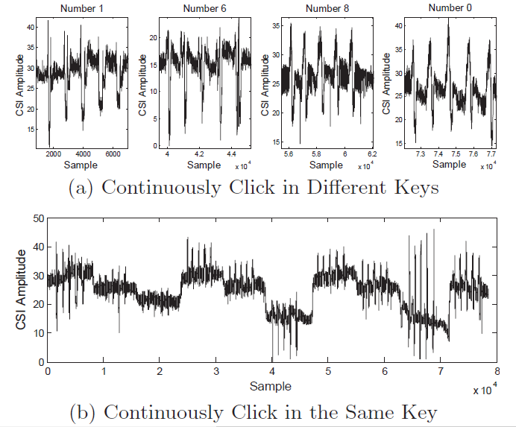
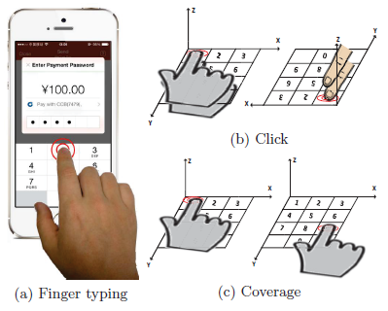
Factors Contributing to CSI Changes
Two major factors that affect the CSI:
Hand coverage and finger position
Finger click
Notes:
To infer keystroke from CSI, we need to identify the factors to the CSI.
Based on the previous work, there are two common typing gesture. Oblique touch is the most common typing gesture when people press different keys. Vertical touch happens when people continuously press the same key.
Therefore, there are two major factors that affect the CSI, one is the hand coverage and finger position, as shown in the right bottom picture
Different finger position and coverage will inevitably introduce the interfer- ence to the WiFi signals and thus lead to the changes of the CSI.
The experiment of continuously typing keys from 0 to 9 shows that different coverages lead to different fluctuation range of CSI values.
Another major factor is finger clicks. The experiment shows that each click could cause a sharp convex on CSI values and produce similar CSI values each time when user type the same key. Using this feature, we can identify whether the user is typing the same keys of adjacent keys quickly or not.

Slide 8
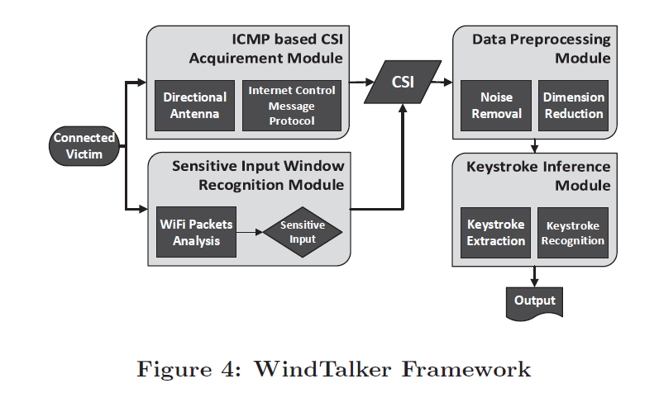
Design of WindTalker
Notes:
Here comes the overview design of windtalker framework.
It has 4 main component. ICMP based CSI acquirement module, Sensitive iput window recognition module, Data preprocessing module, and Keystroke inference module.
First , the attacker use a pretend to be a public wifi hotspot. After connected to the victim, the windtalker starts to run the sensitive input window recognition module and icmp basd csi acquirement module to collect CSI data and record the start and end time of the sensitive input.
After that, windtalker will analysis the csi in the offline phase. It will reduce the noise and reduce data dimension from the original csi data using data preprocessing module.
Finally, attacker will get the assumption keystroke of PIN using the keystroke inference module.
Now lets see function of each component one by one.

Slide 9
Sensitive Input Window Recognition Module
To distinguish the time window of the sensitive input from that of insensitive input, WindTalker captures all the packets of the victim with Wireshark and records timestamp of each CSI data
HTTPS does not protect the metadata of the traffic
WindTalker builds a ‘sensitive IP pool’ and launches its keystroke inference module during access to these IPs
Notes:
The first component is sensitive input window recognition module.
The aim of the attacks is not to know all inputs of the victim, attackers only want to know the private sensitive input like payment password such as PIN number.
Thus, to distinguish the time window of the sensitive input from others is needed.
The windtalker will first capture all the packets of the victim and csi data with its timesteap.
Victim’s transfer packets can not be used to decrypt since they are secred by HTTPS from application to the server. However, HTTPS does nt protect the metadata like the destination IP address, which means we can identify the sensitive input window by capture the timesteap of packets sending to specific IP address. The authors find that, for Alipay users, the traffics under the same network will be directed to the same server IP, and this IP will last for several days.
Therefore, windtalker generate a sensitive IP pools. Windtalker will identify the start and end time of the sensitive input windows and find the corresponding csi data to analyze.

Slide 10
ICMP based CSI Acquirement Module
Leverages Internet Control Message Protocol (ICMP) in hotspot to collect CSI data
WindTalker periodically sends a ICMP Echo Request to the victim smartphone, which will reply an Echo Reply for each request
To acquire enough CSI information of the victim, WindTalker needs to send ICMP Echo Request at a high frequency
Notes:
Next component is ICMP based CSI acquirement module.
Different from the previous works which rely on two devices
Windtalker only uses one device to collect CSI data. To do this, windtalker will send ICMP ECHO request to the victim at a high frequency, which will reply an echo reply for each request.
The ICMP protocol is used to transfer various error and control information between network devices, and it plays a vital role in collecting various network information, diagnosing and troubleshooting network faults.
This method is difficult to detect and avoid. One ICMP echo packet is only 64 bytes, if the attackers send 800 ICMP packets per second to the victim, it only needs 78.4 kbps. It’s hard for victims to notice this flow.
By receiving the ICMP ECHO REPLY packet, attackers could get the CSI information of the victim.
/////For a 98 bytes ICMP packet, when we are sending 800 ICMP packets per second to the victim, it needs only 78.4 kbps for the attack where 802.11n can theoretically support transmission speeds of up to 140 Mbps

Slide 11
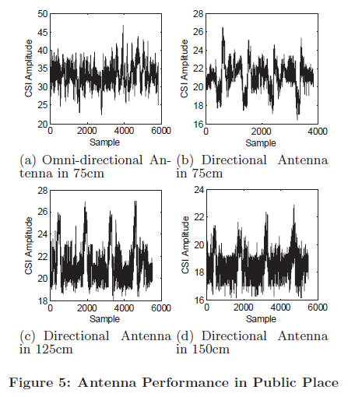
ICMP based CSI Acquirement Module
how to minimize the interference caused by nearby human beings and other objects
Answer = Noise reduction by using a directional antenna
Notes:
One of the major challenges of obtaining the exact CSI data in public space is how to minimize the noise in the CSI data caused by nearby human beings and other objects.
Windtalker uses directional antenna to reduce the noise.
Compared to the Omnidirectional antenna which can transmit and receive signals at all directions,
Directional antenna can send and receive signals in a certain direction.
Attackers could employs directional antenna to focus the energy toward the target of interest, which is expected to minimize the effects of the nearby human body movement.
,

Slide 12
Data Preprocessing Module
CSI first passed through a low pass filter
Dimension reduction is then performed
Uses Principal Component Analysis for the same
Notes:
After collecting sensitive CSI data, we need to preprocess the data before recognition to have a better result.
In the data preprocessing module, windtalker has two part to do, reduce the noise and extract principal component of csi data.
Apart from the noise caused by nearby human and other objects, the requent changes in internal CSI reference levels, the transmit power levels and transmission rates can also generate noise,
To remove internal high frequency noise, the authors adopted a low-pass filter, which is designed to have a flat frequency response in the passband and thus does not distort the finger motion signal much.
Another problem is to reduce data dimension.
As we mentioned before, wifi uses ofdm technology, which means, on each subcarrier attackers will receive a csi data.
Out of these, only the subcarrier which shows the strongest correlation with hand and finger movements should be considered. Therefore, windtalker uses pca to reduce dimension of csi matrix.
PCA is a method of statistical analysis and simplification of data setthe This high demention csi matrix is not suitble for attakers to analyze and do keystroke recognition.
The problem of high-dimensional feature vectors is often easy to fall into the dimensional disaster. As the dimensionality of the data set increases, the number of samples required for algorithm learning increases exponentially. Encountering such big data is very disadvantageous, and learning from big data sets requires more memory and processing power.
Dimensionality reduction can alleviate the dimensional disaster problem. And it can minimize information loss while compressing data.
/////If there are 30 OFDM subcarriers, there are $N_{T_{X}}×N_{R_{X}}×30$ subcarriers in total.

Slide 13
Keystroke Inference Module
Identifying keystrokes is divided into three modules:
Keystroke extraction – To detect start and stop of keystroke. Has three further steps:
Waveform profile building
CSI Time Series Segmentation and Feature Segment Selection
Keystroke Waveforms Extraction
Keystroke recognition – Choosing features to uniquely represent keystrokes.
Classifier training – To recognise the keystrokes based on their waveform shapes
Notes:
The final part is keystroke inference module.
It has three subcomponents, keystroke extraction, keystroke recognition, and classifier training.
First , windtalker will use keystroke extraction to detect the particular start and end time point of each keystroke

Slide 14
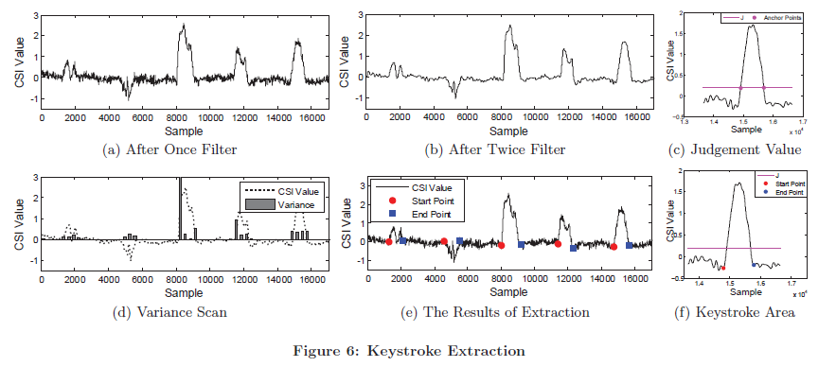
Keystroke Extraction
Notes:
As the figreu (a) shows, the csi data has strong noise which prevent attackers to extract cSI waveform related to the keystrokes.
Windtalker us a butterworth filter and choose a specific frequency to make the waveform smooth.
The result after filter is shown in figure (b).
The next step is slice the CSI time series into multiple segment, and then calculate the variance of each segment, as shown in figure (d). We can obviously find that the variance of segment during the keystroke are larger than other period. we can move the segments with the variance under the predertermined threshold. After that, we could group the adjacent segments based on timestamp so that each group represent a individual keystroke.
The final step is to identify the specific start and end time of each keystroke.
As figure (c)and (f) shows, we could calculate the mean value of variance of each group as J, the red line. The intersection point of J and the csi time series could be the start and end point of keystroke.
To go further, we can do a local search from the intersection point of J and csi time series to find the nearest local extremum which is below J as the start and end point.
With the start and end point, keystroke waveform could be extracted.
After keystroke extraction, we use these keystroke waveform to conduct recognition process.

Slide 15
Keystroke recognition
Keystroke recognition – Choosing features to uniquely represent keystrokes. Uses Discrete Wavelet Transform to compress the waveform and Dynamic Time Warping to determine the similarity between waveforms
Classifier training – To recognise the keystrokes based on their waveform shapes
Notes:
After extract individual waveform, we could run the keystroke recognition.
To avoid high computational costs in the classification process, we should not use the original waveform, since it contain many data points.
Therefore, windtalker uses dscrete wavelet transform to compress the length of CSI waveform by extracting the approximate sequence.
After that , windtalker uses dynamic time warping to compare the extracted waveform to the simple keystroke waveform pattern by calculate the distance between two time series. The output of DTW is the distance between two series. A low distance indicates that these two sequences are highly similar.
Until now, we have done all preparations, the last step is to run a basic classfier training algorithm to identify the exact number of each keystroke.

Slide 16
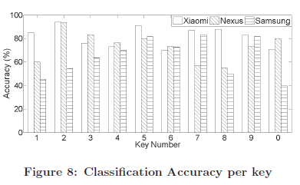
Evaluation
Recruited 10 volunteers and asked them to input number passwords
In the data training phase, WindTalker records each input and its corresponding CSI data
In the test phase, WindTalker infers the input data based on the observed CSI time series
Notes:
Fig.8 shows average classification accuracy of all 10 volunteers in 10 PIN number on different smartphones.
As we can see, for inferring one key, WindTalker achieves average accuracy classification of 81.8% in Xiaomi, 73.2% in Nexus and 64% in Samsung .
As for predict 6-digit payment password, windtalker could calculate the possibility of each possible result and sort them to choose the candidates with highest probabilities.
If we choose the top 3 candidates, the accuracy could reach almost 80%.

Slide 17
Real World Example: Alipay
Deployed at a cafeteria like environment
Simulated real world attack by:
Online training phase – Volunteers enter randomly generated numbers
Normal use phase – Volunteers browse the internet as a normal user
Mobile payment phase – Using Alipay to enter a password and complete a payment
With the traffic meta data, WindTalker obtains the rough start time and end point of Sensitive Input Window via searching packets whose destination is “110.75.xx.xx”
The top three password candidates in this case were 773919, 773619, 773916 while the actual password was 773919
Experiment results show that the attacker can successfully recover 2, 4, 7 and 9 passwords if allowed to try the password input for 5, 10, 50 and 100 times respectively
Notes:
Windtalker has also been tested on real world.
Attackers first deployed windtalker wifi device toward the victim and pretend to be a public wifi hotspot.
After connected to the victim, the windtalker will ask users to input some numbers such as verification codes to obtain victim’s private csi information as training dataset. Then, windtalker will monitor the traffic and the sensitive input window and infer the keystroke.
For alipay, windtalker could successfully recover the password with top 50 candidate results.

Slide 18
Limitations
Hardware limitations - In WindTalker, the authors used Intel 5300 NIC and Linux 802.11n CSI Tool. In their experiments, it was observed that the system would crash when they performed ICMP based CSI data collection for iPhone or some versions of Android smart phones
Fixed typing gesture – WindTalker only works in scenarios where the user touches the screen with relatively fixed gesture and if the phone is in a stable environment like a table
User specific training - Hard to adopt the classifiers trained by other people to infer the victim’s input
Notes:
Windtalker also has some limitations,
The first one is that the csi tools on intel NICs has some conlicts to iphone. The tools may crash during connecting to iphone.
The major problem is the the csi information is highly relative to telecommunication environment. And the major fact is the typing gesture, if user constantly change the typing gesture, then the collected csi dataset cannot be used to recover the correct input. What’s more, the reliability of csi data can not last long even though users use a fixed typing gesture, because the environment will change and that will impact the value of csi information.
Also, windtalker can only infer the victim with his own training dataset. Since everyone has different typin gesture which generates different csi pattern.
This concludes my speech, thank for listening , any questions?

